Slide 1
Weekly report: Tower structure
Week number: 08
Date: 18/11/2025
Supervisor: Prof. Faber
Group members: Ibrahim Mostafa, Mohammed Eldemerdash, Kirollos Ghaly
Speaker: Mohammed Eldemerdash (760137)
18/11/2025
1
Speaker: Mohammed Eldemerdash (760137)
Tower structure team/ Optimus Syria

Slide 2
List of contents
Optimizing the tower design.
Modelling the tower in SolidWorks.
The next tasks
18/11/2025
2
Speaker: Mohammed Eldemerdash (760137)
Tower structure team/ Optimus Syria

Slide 3
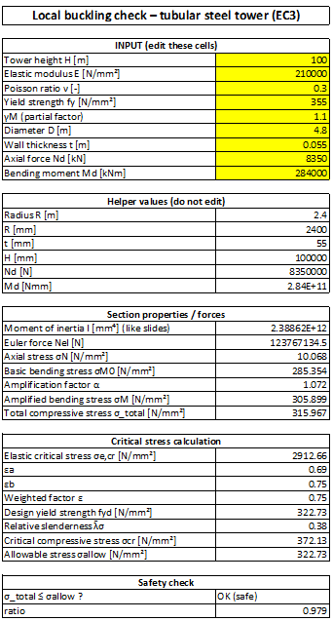
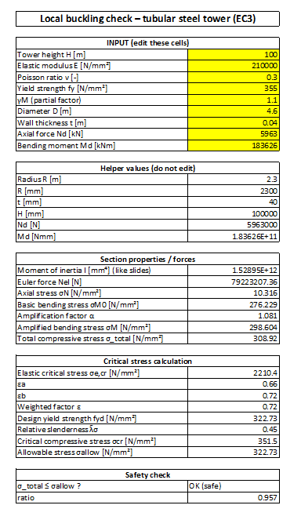
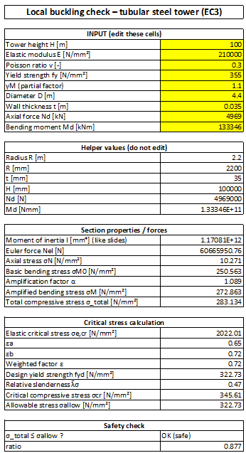

Optimizing the tower design
18/11/2025
3
Speaker: Mohammed Eldemerdash (760137)
Tower structure team/ Optimus Syria

Slide 4
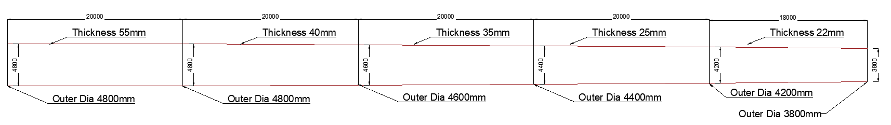
Optimizing the tower design
Changes to the dimensions of the tower:
Part one: no changes.
Part two: thickness reduced from 50 mm to 40 mm.
Part three: thickness reduced from 45 mm to 35 mm.
Part four: thickness reduced from 40 mm to 25 mm.
Part five: thickness reduced from 35 mm to 22 mm.
18/11/2025
4
Speaker: Mohammed Eldemerdash (760137)
Tower structure team/ Optimus Syria

Slide 5
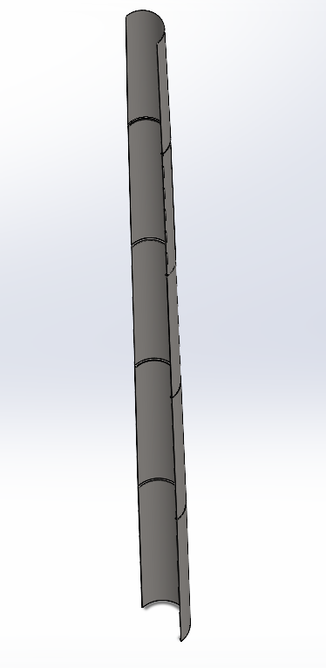
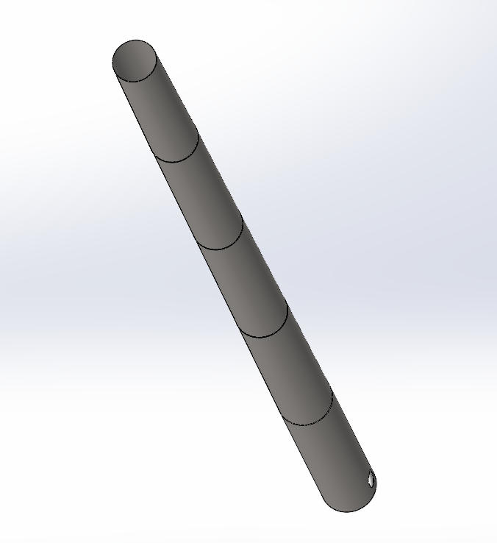
Modelling the tower in SolidWorks
18/11/2025
5
Speaker: Mohammed Eldemerdash (760137)
Tower structure team/ Optimus Syria

Slide 6
The next tasks
Import the SolidWorks model into the ANSYS program to obtain the exact eigenfrequency and tower deflection values.
Prepare the Campbell diagram and the production range.
18/11/2025
6
Speaker: Mohammed Eldemerdash (760137)
Tower structure team/ Optimus Syria

